Slide 1
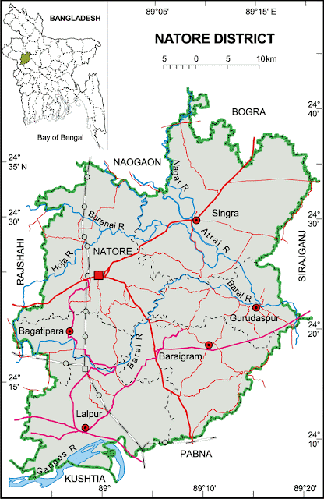
Natore District
A. Sales Universe: 5000
R SO: 872
Market Share: 17.44%
V SO:886
Market Share: 17.72%
O SO:593
Market Share: 11.86% X SO:323
Market Share: 6.46%
S SO:833
Market Share:16.66 %
T SO:269
Market Share:5.38 %
I SO:302
Market Share: 6.04%
Others:922
Market Share: 18.44%
B. Retail Univers:55
R WOD: 43
V WOD: 35
O WOD: 36
X WOD: 30 S WOD: 40
T WOD: 22
I WOD: 22
Others:44
C. BS Universe: 11
R BS: 2
R BS Share: 18.18%
V BS: 2
V BS Share: 18.18%
O BS: 1
O BS Share: 9.09%
X BS: 1
X BS Share: 9.09% S BS: 5
S BS Share: 45.45%
T BS: 00
I BS: 00
Others: 00
D. CS Univers:9
R CS: 7
R CS Share: 77.78%
V CS: 4
V CS Share: 44.44%
O CS: 3
O CS Share:33.33%
X CS: 2
X CS Share:22.22% S CS: 3
S CS Share:33.33%
T CS: 1
T CS Share:11.11%
I CS: 1
I CS Share:11.11%
Others: 5
Others CS Share: 45%
E. Universe: 35
R : 34
R Share: 97.14%
V : 29
V Share: 82.85%
O : 32
O Share: 91.43%
X : 27
X Share:77.14 % S : 32
S Share:91.43%
T : 21
T Share:60%
I : 21
I Share:60%
Others: 39
Others Share:100%
G. R RSM: 1
R ASM: 1
R TSM: 1
V RSM: 1
V ASM: 1
V TSM: 1
O RSM: 1
O ASM: 1
O TSM: 1
X RSM: 1
X ASM: 1
X TSM: 1
S RSM: 1
S ASM: 1
S TSM: 1
T RSM: 1
T ASM: 1
T TSM: 0
I RSM: 1
I ASM: 1
I TSM: 1
F. realme Dealer: 1
TTL Investment: 90Lac
Inventory: 64 Lac
Market due: 7 Lac
Natore District (7 Thana)

Slide 2
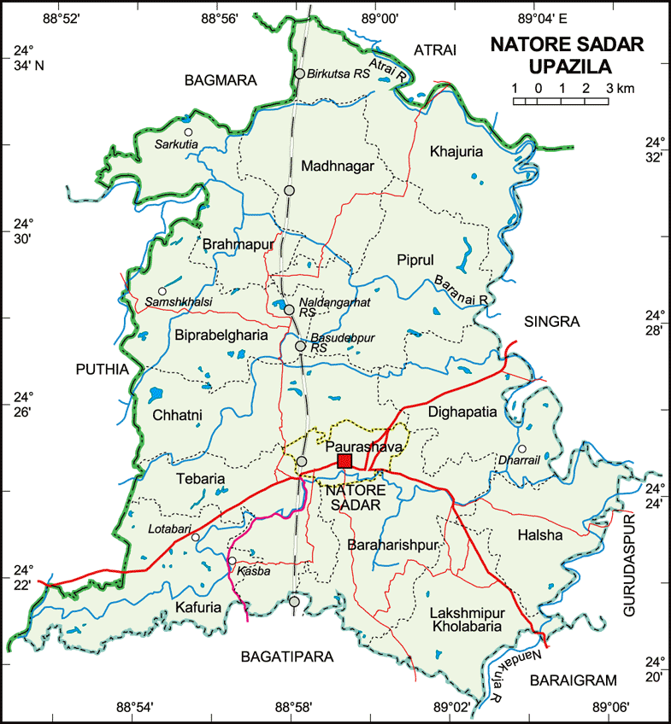
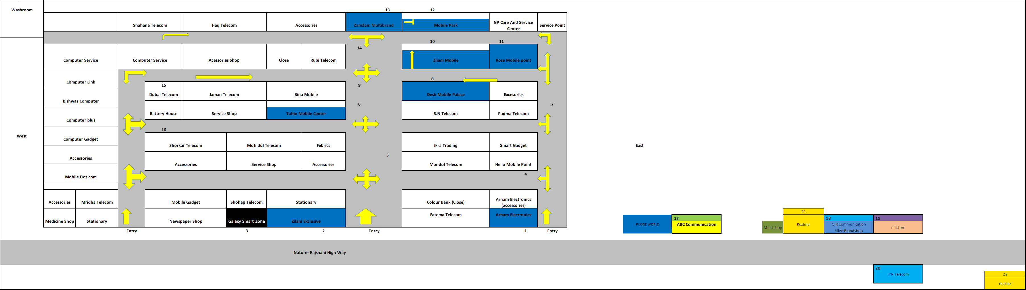
Natore_Sadar Market:
E. GRT Universe: 8
R : 8(16pcs)
R Share: 100%
V : 8(18 pcs)
V Share: 100%
O :8(12pcs)
O Share: 100% X : 8(10 pcs)
X Share: 100%
S : 8 (8pcs)
S Share: 100%
T : 6 (10pcs)
T Share: 75%
I : 7 (8pcs)
I Share: 87.5%
Other: 8 (20pcs)
Others Share: 100%
A. Market Review:
Sales Universe: 2368
R SO: 397
R MKT Share: 16.78%
V SO:407
V MKT Share:17.20%
O SO:282
O MKT Share:11.90% X SO:167
X MKT Share:7.05%
S SO:512
S MKT Share:21.64%
T SO:94
T MKT Share:3.97%
I SO:130
I MKT Share:5.48%
Other:579
I MKT Share:16%
B. Retail Universe: 23
R WOD: 13
V WOD-13
O WOD: 14
X WOD: 10 S WOD:14
T WOD: 7
I WOD: 8
Others WOD: 13
C. BS Universe: 10
R BS: 2 (95pcs)
R BS Share: 20%
V BS: 2 (32pcs)
V BS Share: 20%
O BS: 1 (41pcs)
O BS Share: 10% X BS: 1 (38pcs)
X BS Share: 10%
S BS: 4 (74pcs)
S BS Share: 40%
T BS: 00 (00pcs)
I BS: 00 (00pcs)
Other: 00 (00pcs)
D. CS Universe: 7
R CS: 3 (85 pcs)
R CS Share: 42.85%
V CS-4 (50pcs)
V CS Share: 42.85%
O CS-2 (42pcs)
O CS Share: 28.57% X CS: 1 (30pcs)
X CS Share: 14.28%
S CS: 2 (45pcs)
S CS Share: 28.57%
T CS: 01 (32pcs)
T CS Share: 14.28%
I CS: 01 (30pcs)
I CS Share: 14.28%
Other: 5 (55pcs)
Others CS Share: 71.42%
F. realme Dealer: 1
TTL Investment: 90Lac
Inventory:22 Lac
TTL Market due: 7Lac Sadar Market Due: 1.5 lac
G. realme RSM: 1
realme ASM: 1
TSM: 1
Main market – Natore Distance
Market Map – Sadar Thana

Slide 3
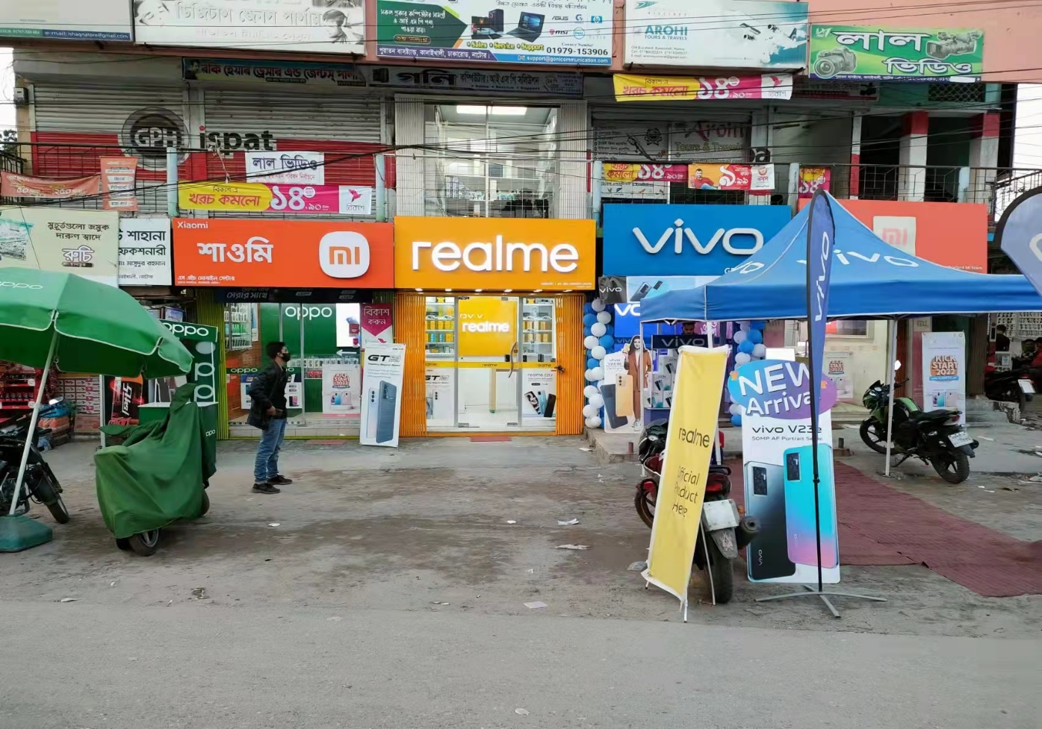
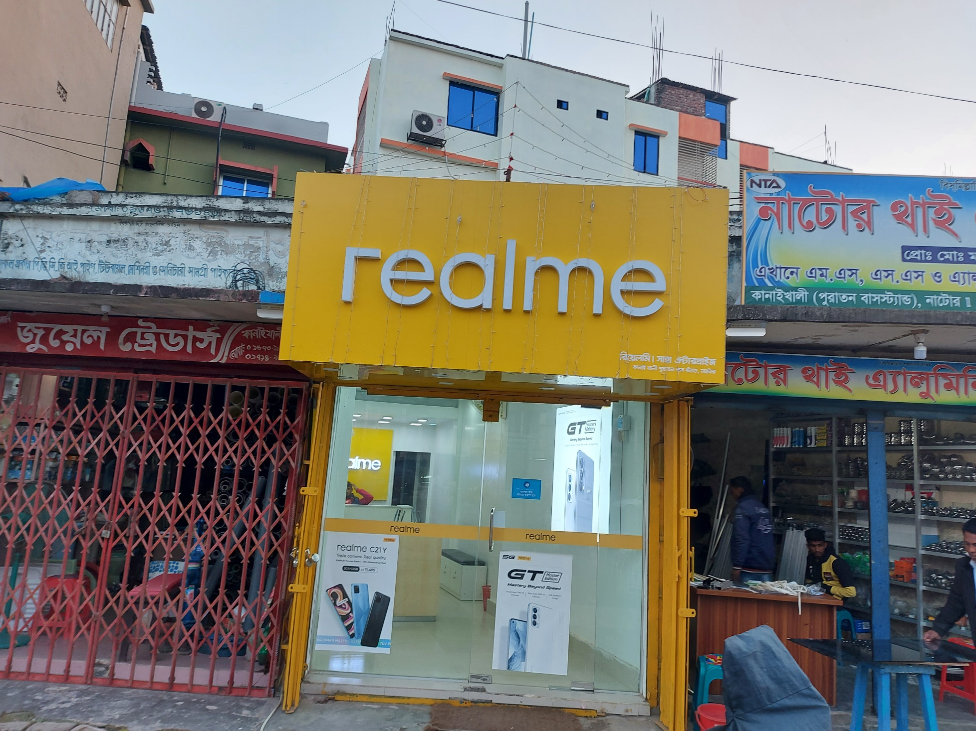
Natore Sadar Market (Realme BS)
SH Mobile Center Showroom:
Sales Universe: 82
R SO: 82
Saha Enterprise Showroom:
Sales Universe: 100
R SO: 100

Slide 4
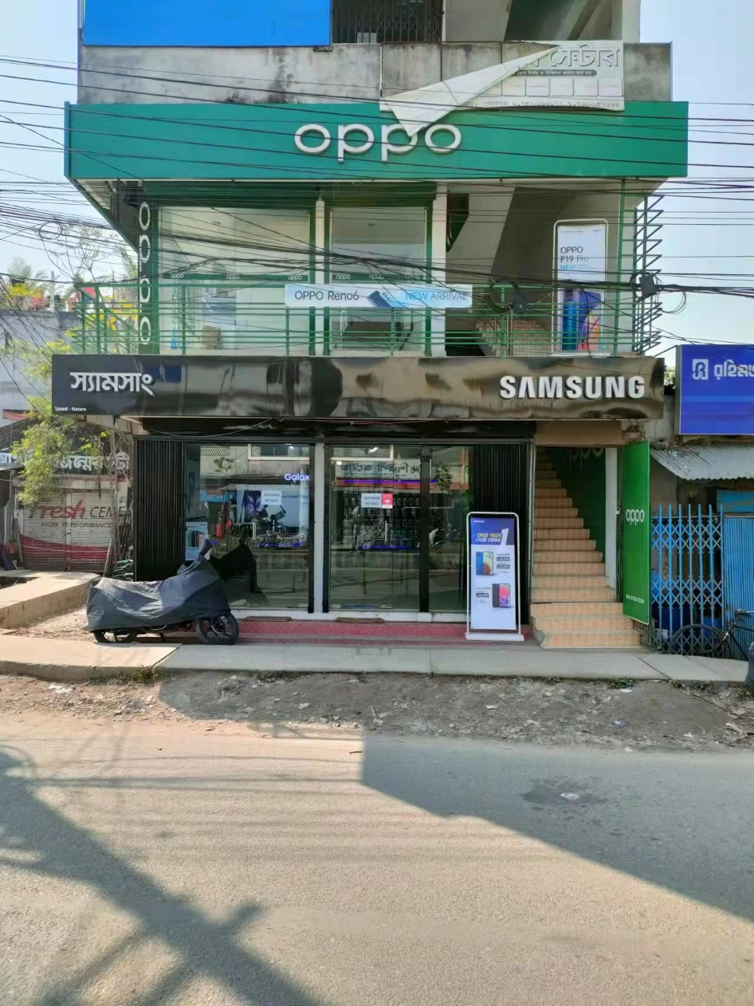
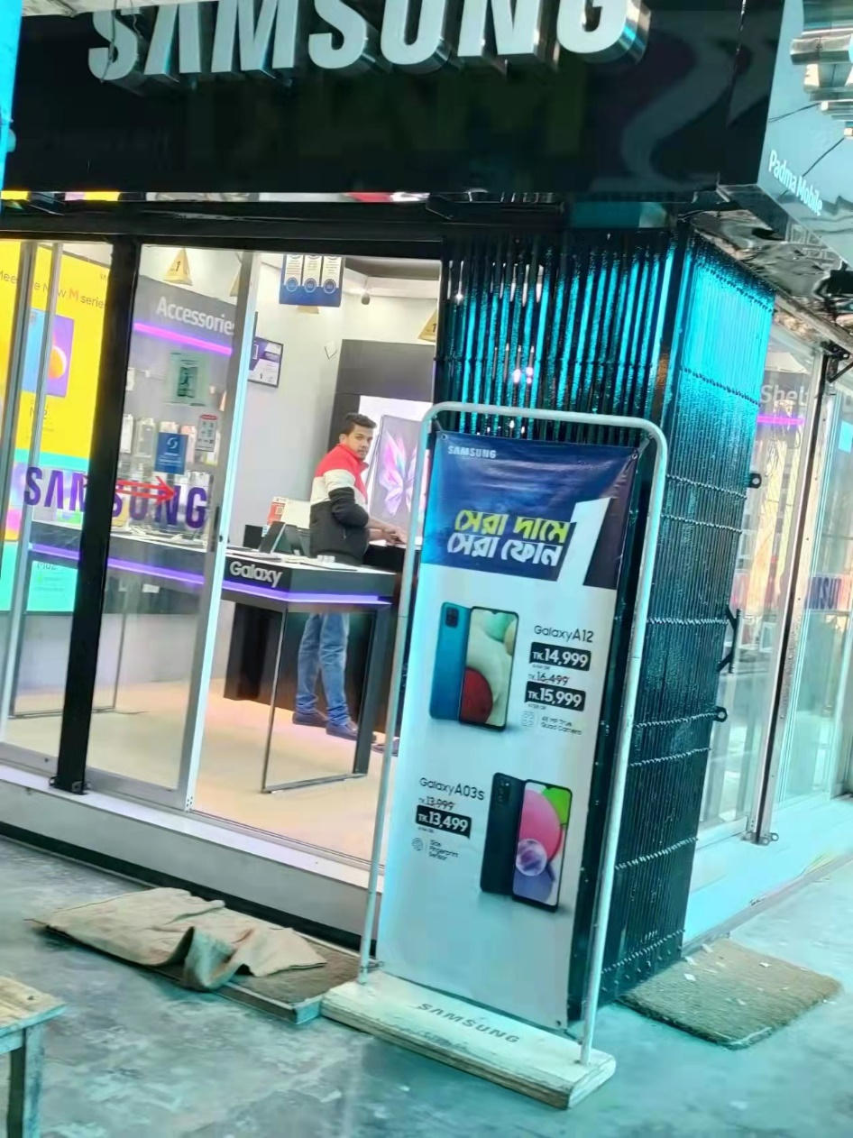
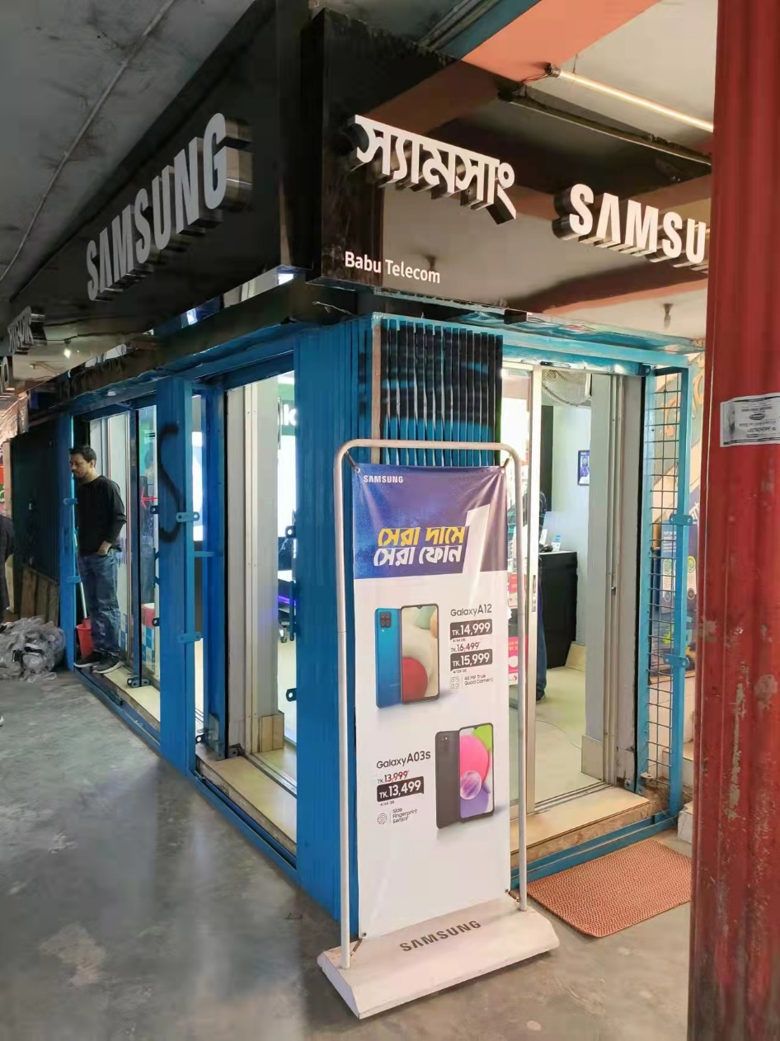
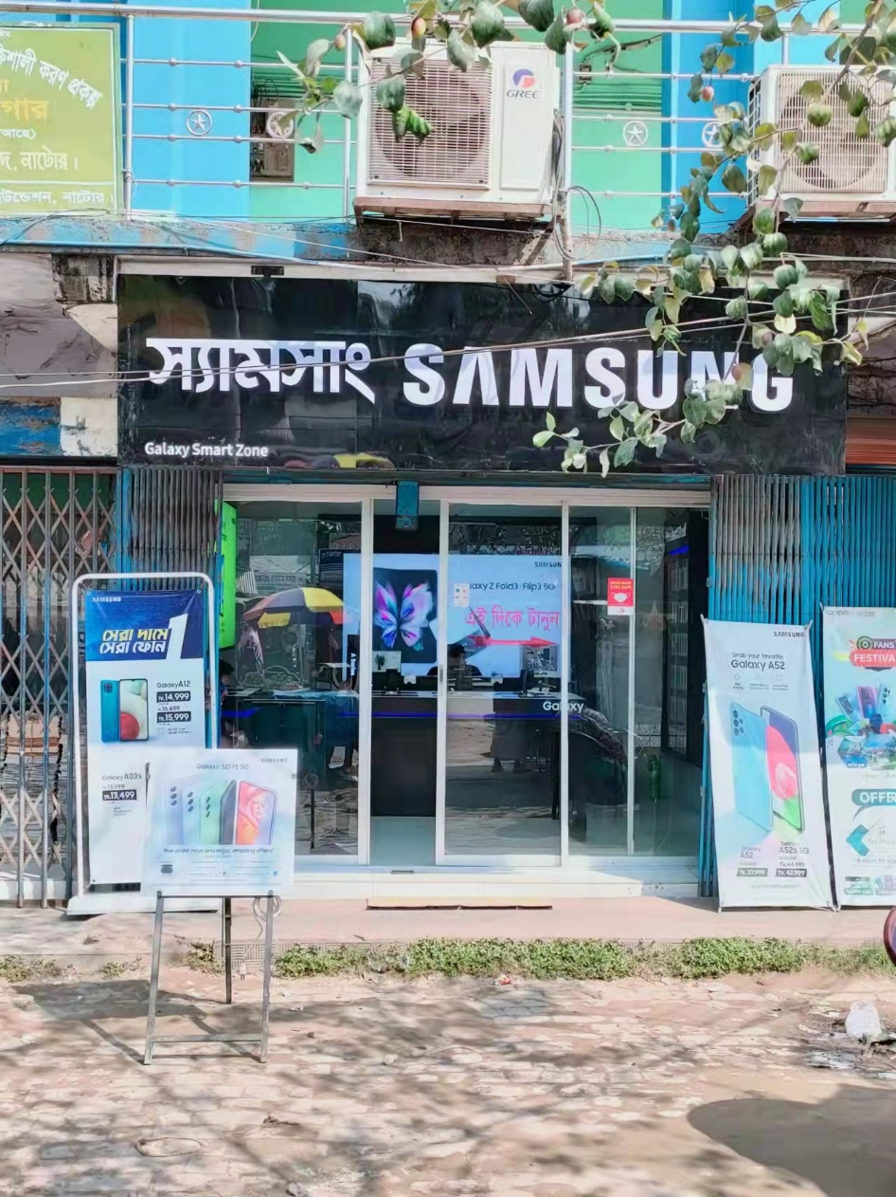
Natore Sadar Market (Samsung BS)
Speed Natore:
Sales Universe: 71
S SO: 71
Padma-Mobile:
Sales Universe: 76
S SO: 76
Nabila Telecom:
Sales Universe: 46
S SO: 46
Galaxy Smart Zone:
Sales Universe: 50
S SO: 50

Slide 5

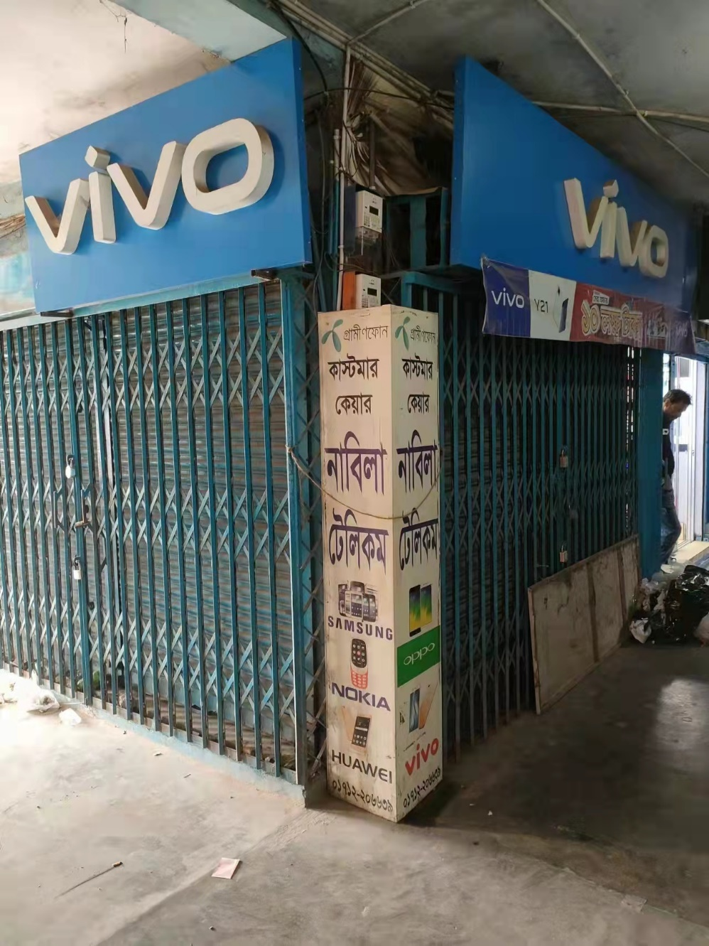
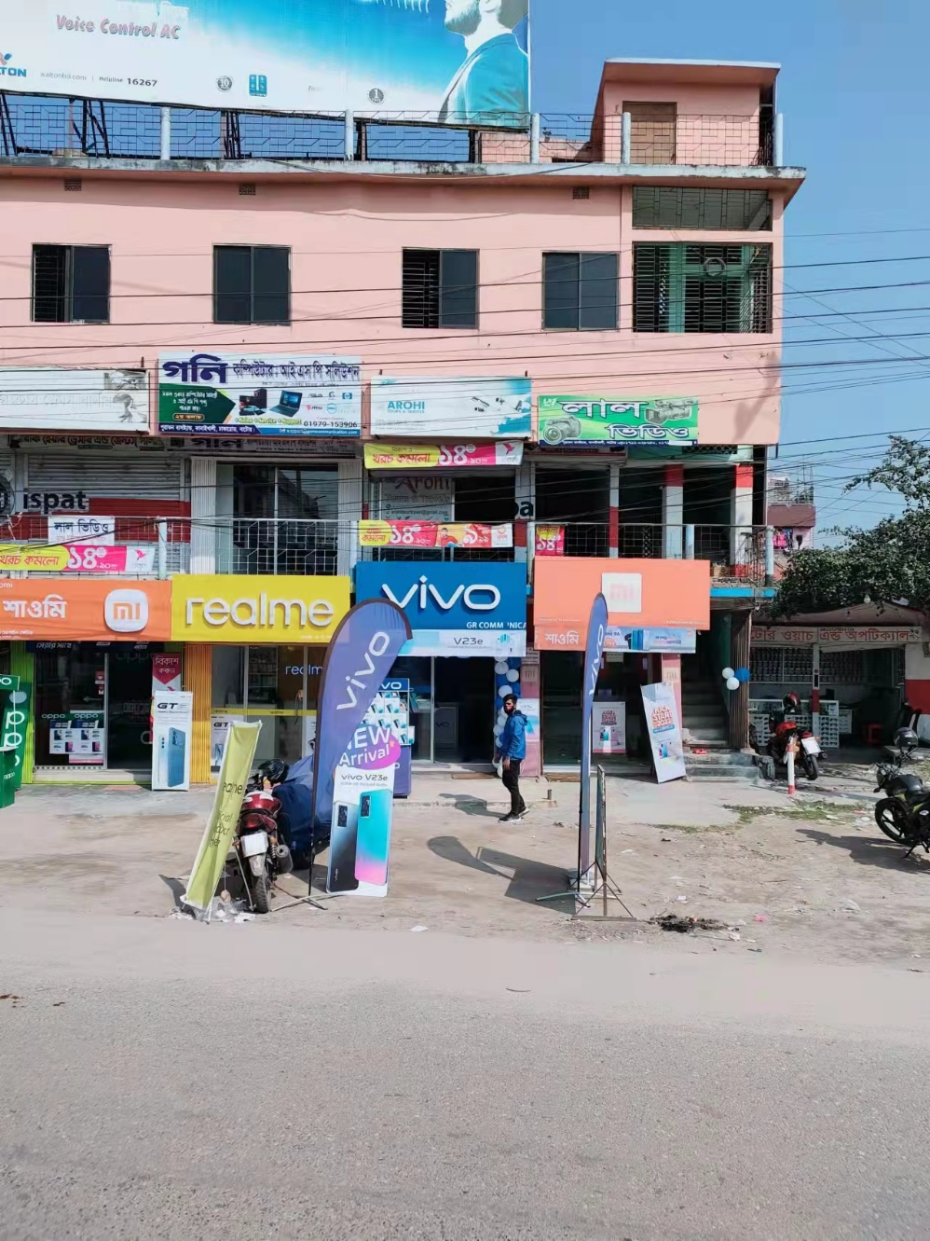
Natore Sadar Market (MI, Vivo, Oppo BS)
Wasif Telecom:
Oppo Brand Showroom
Sales Universe: 35
O SO: 35
Himig Brandshop:
Vivo Brand Showroom
Sales Universe: 18
V SO: 18
GR Communication: Vivo Brand Showroom
Sales Universe: 40
V SO: 40
GR Communication:
MI Brand Showroom
Sales Universe: 31
X SO: 31

Slide 6
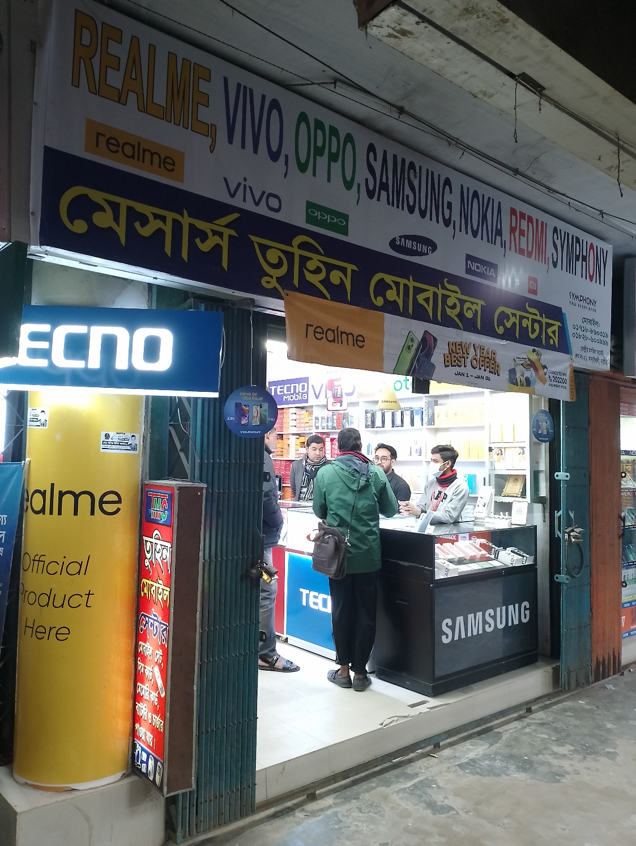
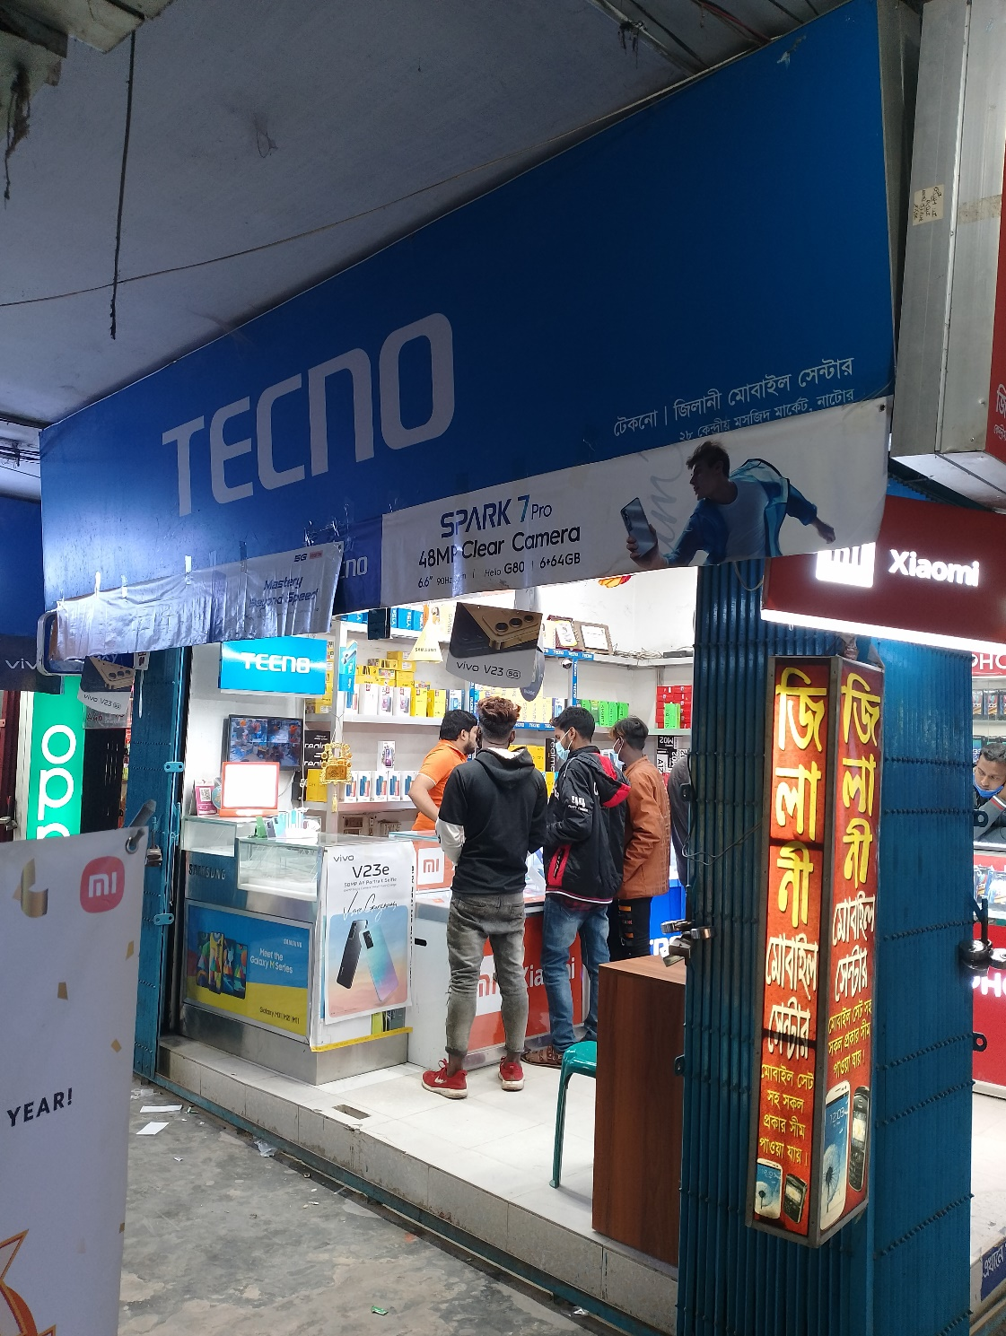
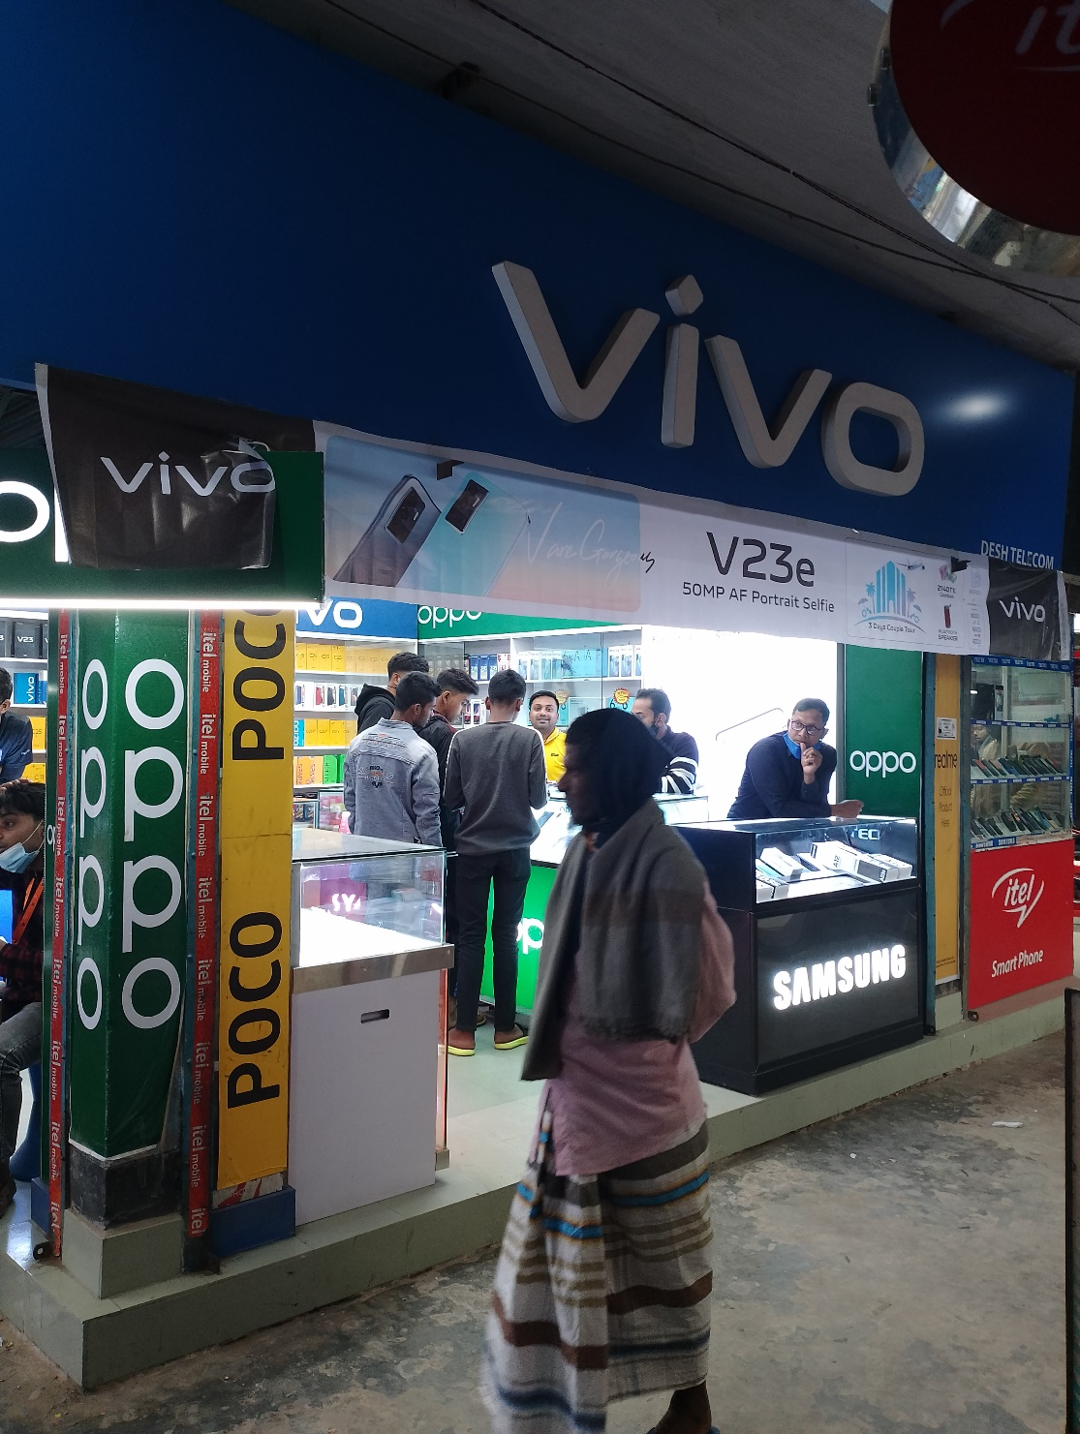
Natore Sadar Market (CS)
CS Shop:
TTL 3 realme Cs Shop
TTL CS Sale: 255
Average Sale:85 pcs
Plan: Need to Bell Sign/
Some Sticker Branding
Tuhin Mobile:
Sales Universe: 320
R SO: 78
V SO: 19
O SO: 51
S SO:34
X SO: 24
T SO: 28
I SO: 16
Others: 70
Zilani Exclusive:
Sales Universe:381
R SO: 102
V SO: 49
O SO: 32
S SO:42
X SO: 30
T SO: 32
I SO: 21
Others:73
Desh Telecom:
Sales Universe:239
R SO: 75
V SO: 25
O SO: 26
S SO:15
X SO:27
T SO: 9
I SO: 18
Others: 44

Slide 7
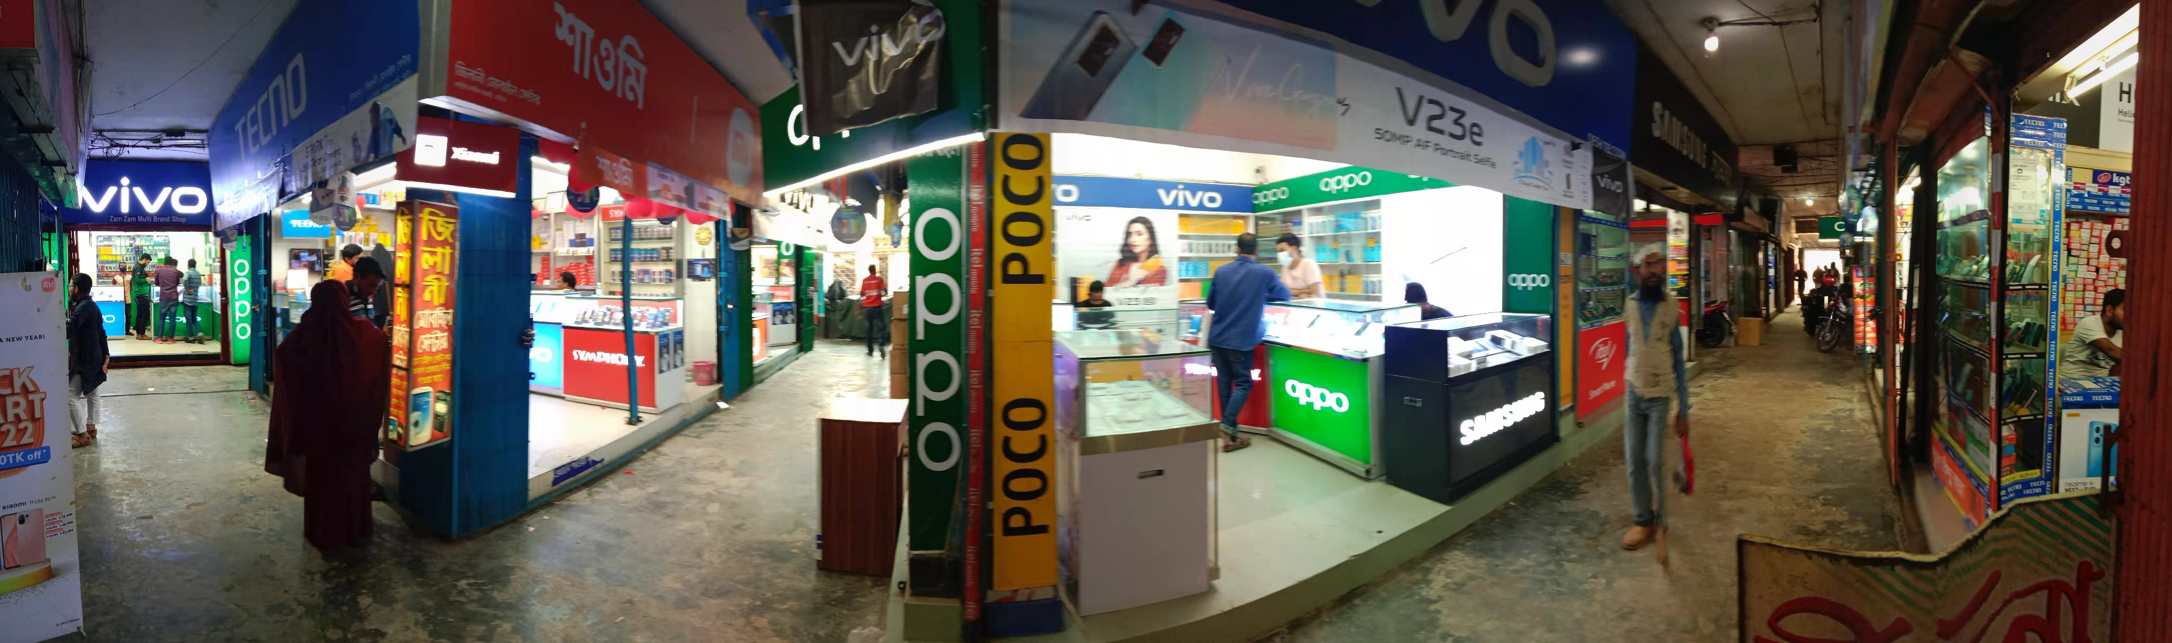
Natore Sadar Market (GRT)
GRT Shop:
TTL 8 realme Shop
TTL Sale:820 Pcs
Average Sale: 102pcs
R : 16pcs
V : 18 pcs
O :12pcs X : 10 pcs
S : 8pcs
T : 10pcs
I : 8pcs
Other: 20pcs
Plan: Some Sticker Branding

Slide 8
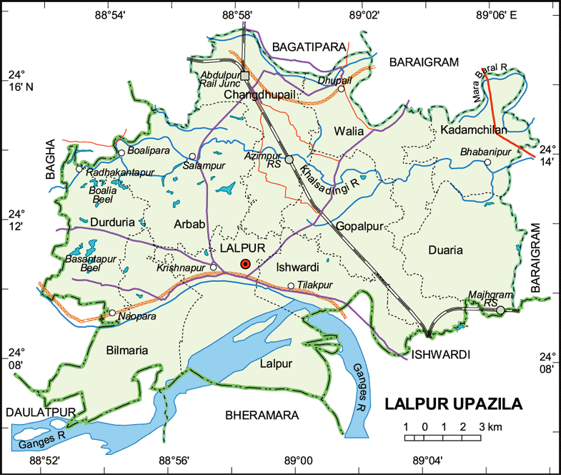
Natore Lalpur Thana Market:
A. Market Review:
Sales Universe: 450
R SO: 100
R MKT Share: 22.22%
V SO:67
V MKT Share:14.89%
O SO:70
O MKT Share:15.55% X SO:19
X MKT Share:4.22%
S SO:39
S MKT Share:8.66%
T SO:52
T MKT Share:11.56%
I SO:15
I MKT Share:3.33%
Other:88
I MKT Share:19.55%
B. Retail Universe: 4
R WOD: 4
V WOD-4
O WOD: 4
X WOD: 4 S WOD:4
T WOD: 4
I WOD: 4
Others WOD: 4
C. BS Universe: 0
R BS: 0
R BS Share: 0
V BS: 0
V BS Share: 0
O BS: 0
O BS Share:0 X BS: 0
X BS Share:0
S BS: 0
S BS Share:0
T BS:0
I BS: 0
Other: 0
D. CS Universe: 2
R CS: 2 (94 pcs)
R CS Share: 100%
V CS :1 (42 pcs)
V CS Share: 50%
O CS:1 (40 pcs)
O CS Share: 50% X CS: 0
X CS Share: 0
S CS: 0
S CS Share: 0
T CS: 0
T CS Share: 0
I CS: 0
I CS Share: 0
Other: 0
Others CS Share:0
E. Universe: 2
R : 2(6pcs)
R Share: 100%
V : 3(10 pcs)
V Share: 100%
O :3(31pcs)
O Share: 100% X : 4(9 pcs)
X Share: 100%
S : 4(39 pcs)
S Share: 100%
T : 4 (38pcs)
T Share: 100%
I : 4 (15pcs)
I Share: 100%
Other: 4 (86pcs)
Others Share: 100%
F. realme Dealer: 1
TTL Investment: 90Lac
Inventory:12 Lac
TTL Market due: 7Lac
Lalpur Market Due: 3.5 lac
G. realme RSM: 1
realme ASM: 1
TSM: 1
Main market – Natore Distance
Market Map – Lalpur Thana

Slide 9
Natore Lalpur Thana Market (BS)
No Brand shop

Slide 10
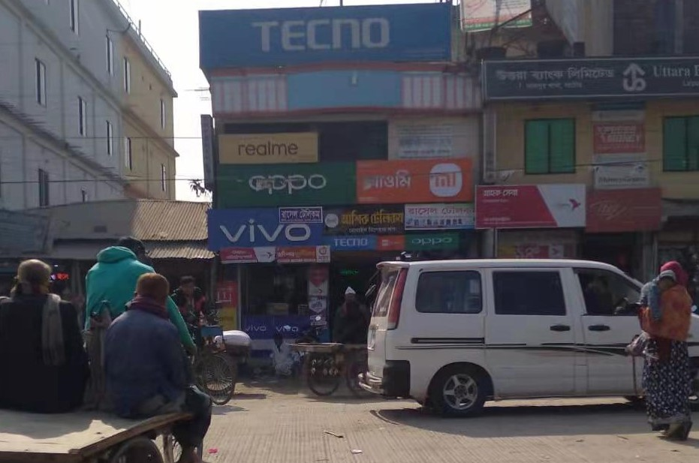
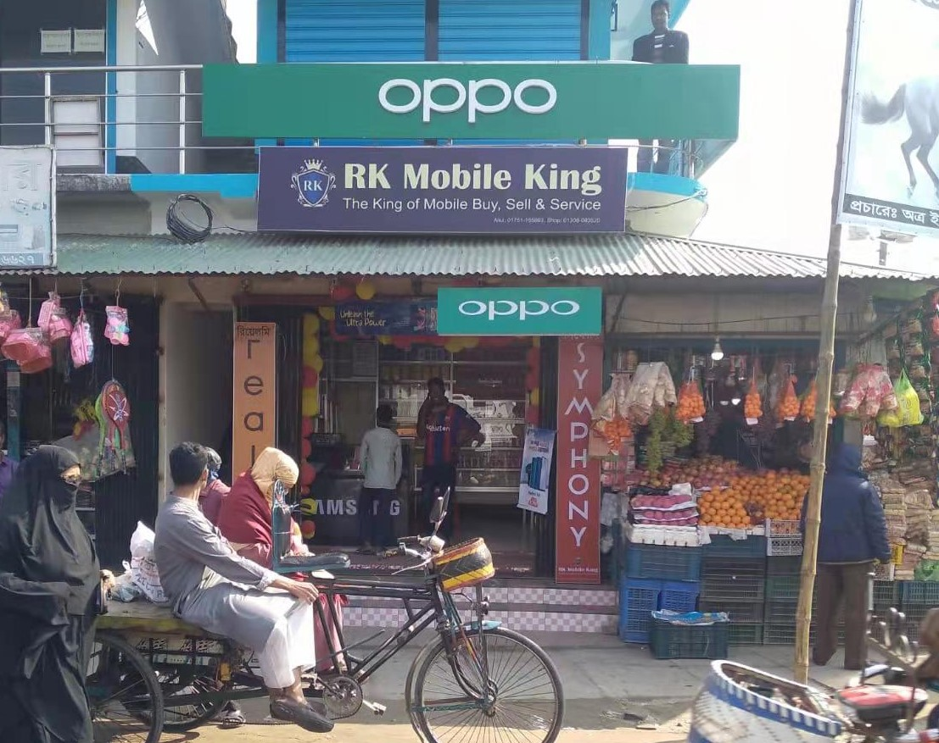
Natore Lalpur Thana Market (CS)
Rasel Telecom:
Sales Universe: 221
R SO: 55
V SO: 41
O SO: 40
S SO:18
X SO: 22
T SO: 15
I SO: 13
Others: 17
CS Shop:
TTL 2 realme Cs Shop
TTL R CS Sale: 94
Average Sale:160 pcs
Plan: Need to Signboard , Shilling Light box
Kabir Telecom Lalpur:
Sales Universe: 100
R SO: 40
V SO: 4
O SO: 5
S SO:12
X SO: 5
T SO: 5
I SO: 4
Others: 25

Slide 11
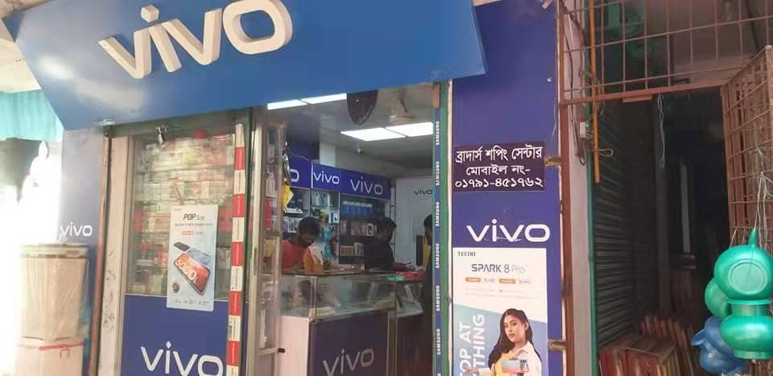
Natore Lalpur Thana Market (GRT)
Shop:
TTL GRT 2 Shop
TTL Sale: 129 Pcs
Agerage Sales: 65
Sales Universe: 65
R SO: 13
V SO: 15
O SO: 10
S SO:7
X SO:5
T SO: 4
I SO: 3
Others:8
Plan: Some Sticker Branding

Slide 12
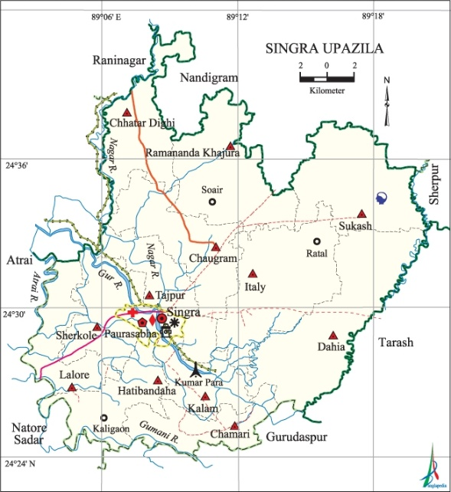
Natore Singra Thana Market:
A. Market Review
Sales Universe: 409
R SO: 72
R MKT Share: 17.60%
V SO:57
V MKT Share:13.93%
O SO:38
O MKT Share:9.29% X SO:35
X MKT Share:8.55%
S SO:84
S MKT Share:20.53%
T SO:17
T MKT Share:1.71%
I SO:30
I MKT Share:7.33%
Other:76
I MKT Share:18.58%
B. Retail Universe: 5
R WOD: 2
V WOD-2
O WOD: 2
X WOD: 2 S WOD:3
T WOD: 2
I WOD: 2
Others WOD: 5
C. BS Universe: 1
R BS: 0
R BS Share: 0
V BS: 0
V BS Share: 0
O BS: 0
O BS Share:0 X BS: 0
X BS Share:0
S BS: 1
S BS Share:100%
T BS:0
I BS: 0
Other: 0
D. CS Universe: 1
R CS: 1 (50 pcs)
R CS Share: 100%
V CS:0
V CS Share:
O CS:0
O CS Share:0 X CS: 0
X CS Share: 0
S CS: 0
S CS Share: 0
T CS: 0
T CS Share: 0
I CS: 0
I CS Share: 0
Other: 0
Others CS Share:0
E. Universe: 4
R : 1(22pcs)
R Share: 20%
V : 2(57pcs)
V Share: 40%
O :2(38pcs)
O Share: 40% X : 2(35 pcs)
X Share: 40%
S : 2(30 pcs)
S Share: 40%
T : 2 (17pcs)
T Share: 40%
I : 2 (30pcs)
I Share: 40%
Other: 4 (76pcs)
Others Share:80%
F. realme Dealer: 1
TTL Investment: 90Lac
Inventory: 3.5 Lac
TTL Market due: 7Lac
Lalpur Market Due: .5 lac
G. realme RSM: 1
realme ASM: 1
TSM: 1
Main market – Natore Distance
Market Map –Singra Thana

Slide 13
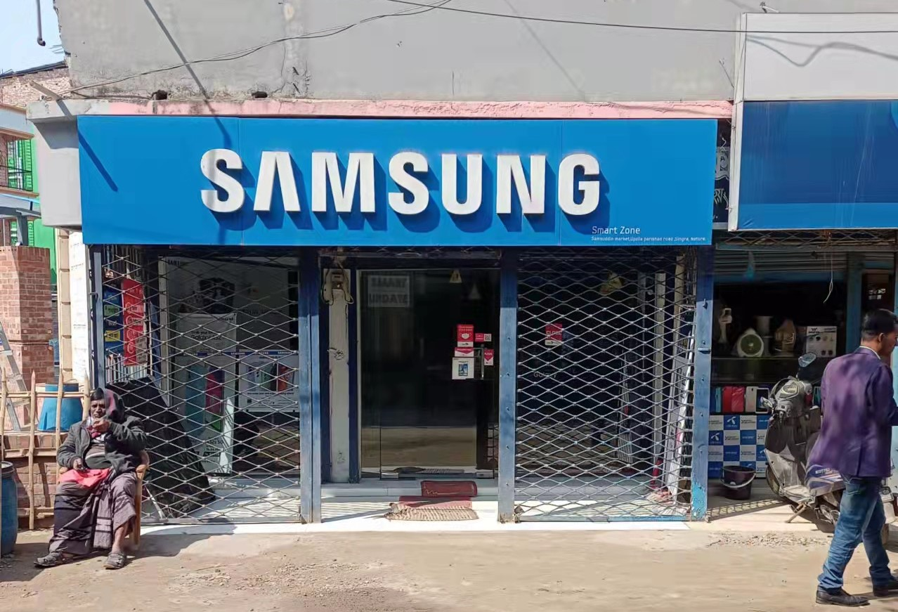
Natore Singra Thana Market (BS)
Smart Zone Samsung Brand Showroom:
Sales Universe: 55
S SO: 55

Slide 14
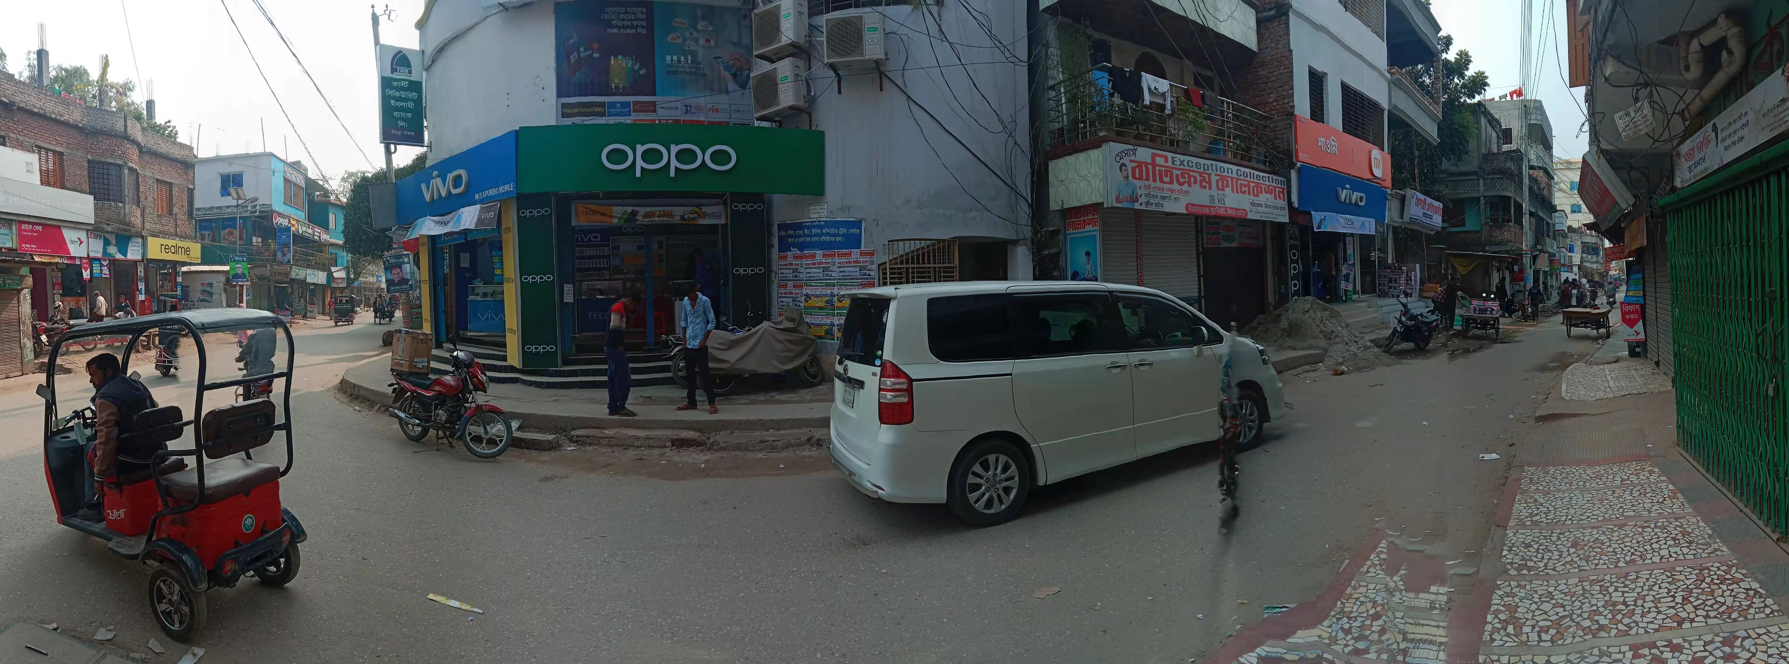
Natore Singra Thana Market (CS)
Dighe Telecom:
Sales Universe: 206
R SO: 50
V SO: 37
O SO: 27
S SO:22
X SO: 17
T SO: 15
I SO: 13
Others: 25
CS Shop:
TTL 1 realme Cs Shop
TTL CS Sale: 206
Average Sale:206 pcs
Plan: Need to Signboard , Shilling Light box

Slide 15

Natore Singra Thana Market (GRT)
Sales Universe: 61
R SO: 5
V SO: 10
O SO: 8
S SO:6
X SO:7
T SO: 3
I SO: 6
Others: 16
Shop:
TTL 5 GRT Shop
TTL Sale: 305Pcs
Average sales: 61pcs
Plan: Need to Bell Sign, Shilling Light box

Slide 16
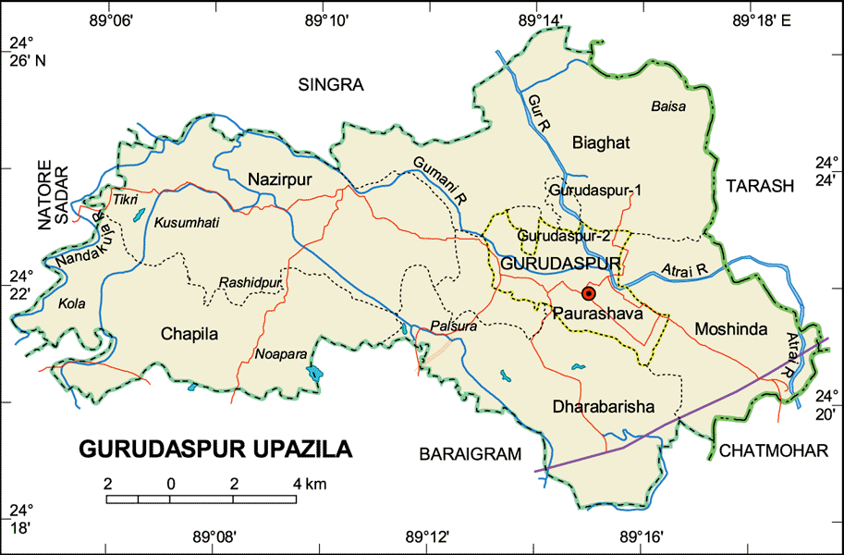
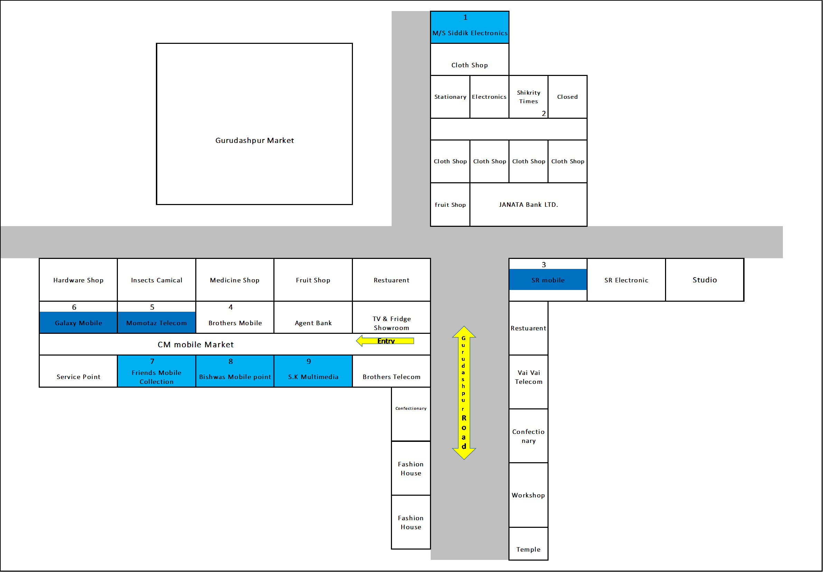
Natore Gurudaspur Thana Market:
A. Market Review
Sales Universe: 726
R SO: 147
R MKT Share:20.24 %
V SO:90
V MKT Share12.39:%
O SO:78
O MKT Share:10.74% X SO:35
X MKT Share:4.82%
S SO:67
S MKT Share:9.22%
T SO:29
T MKT Share:3.93%
I SO:95
I MKT Share:13.08%
Other:185
I MKT Share:25.48%
B. Retail Universe: 8
R WOD: 8
V WOD-8
O WOD: 8
X WOD: 8 S WOD:8
T WOD: 8
I WOD: 8
Others WOD: 8
C. BS Universe: 0
R BS: 0
R BS Share: 0
V BS: 0
V BS Share: 0
O BS: 0
O BS Share:0 X BS: 0
X BS Share:0
S BS: 0
S BS Share:0
T BS:0
I BS: 0
Other: 0
D. CS Universe: 2
R CS: 2 (103 pcs)
R CS Share: 100%
V CS:0
V CS Share:
O CS:0
O CS Share:0 X CS: 0
X CS Share: 0
S CS: 0
S CS Share: 0
T CS: 0
T CS Share: 0
I CS: 0
I CS Share: 0
Other: 0
Others CS Share:0
E. Universe: 6
R : 6(44pcs)
R Share: 100%
V : 8(90pcs)
V Share: 100%
O :8(78pcs)
O Share: 100% X : 8(35 pcs)
X Share: 100%
S : 8(67 pcs)
S Share: 100%
T : 8 (29pcs)
T Share: 100%
I : 8(95pcs)
I Share: 100%
Other: 8 (185pcs)
Others Share:100%
F. realme Dealer: 1
TTL Investment: 90Lac
Inventory: 11.5 Lac
TTL Market due: 7Lac
Lalpur Market Due: .5 lac
G. realme RSM: 1
realme ASM: 1
TSM: 1
Main market – Natore Distance
Market Map –Gurudaspur Thana

Slide 17
Natore Gurudaspur Thana Market (BS)
No Brand shop

Slide 18
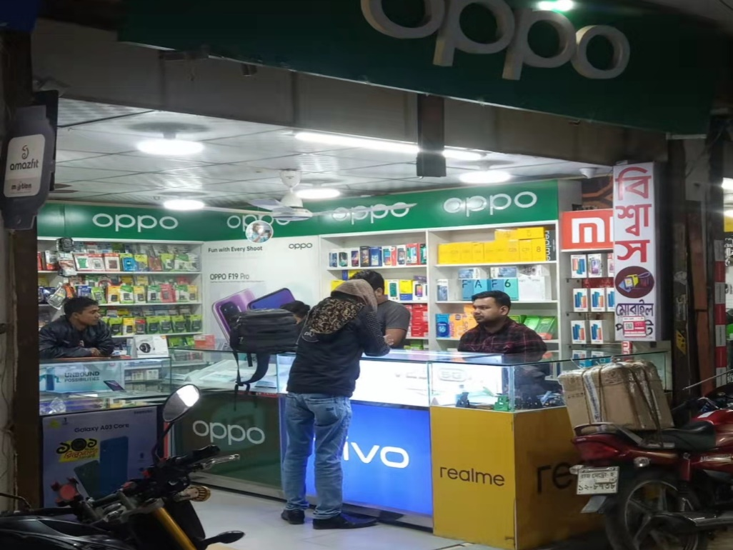
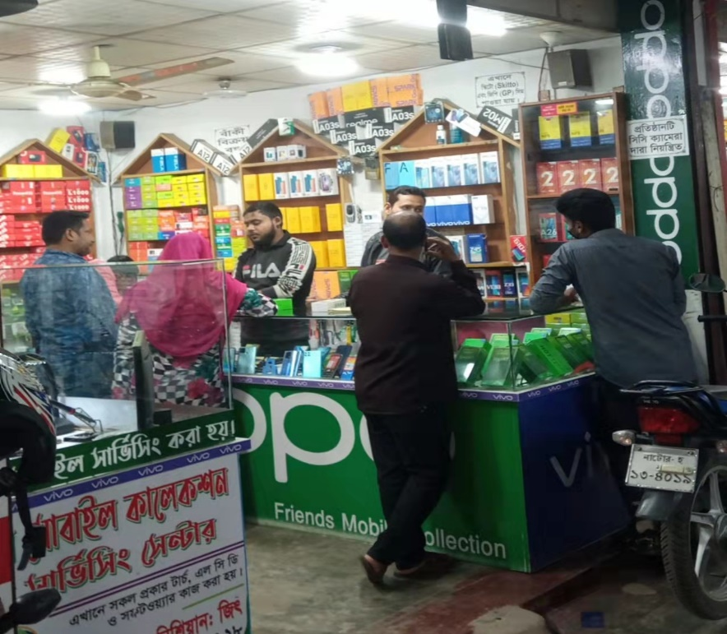
Natore Gurudaspur Thana Market (CS)
Biswas Mobile :
Sales Universe: 183
R SO: 60
V SO: 27
O SO: 20
S SO:27
X SO: 12
T SO: 7
I SO: 5
Others: 25
Friends Mobile:
Sales Universe: 122
R SO: 45
V SO: 15
O SO: 12
S SO:13
X SO:5
T SO: 4
I SO: 3
Others: 25
CS Shop:
TTL 2 realme Shop
TTL Sale:305Pcs
Plan: Need to Bell Sign, Shilling Light box

Slide 19
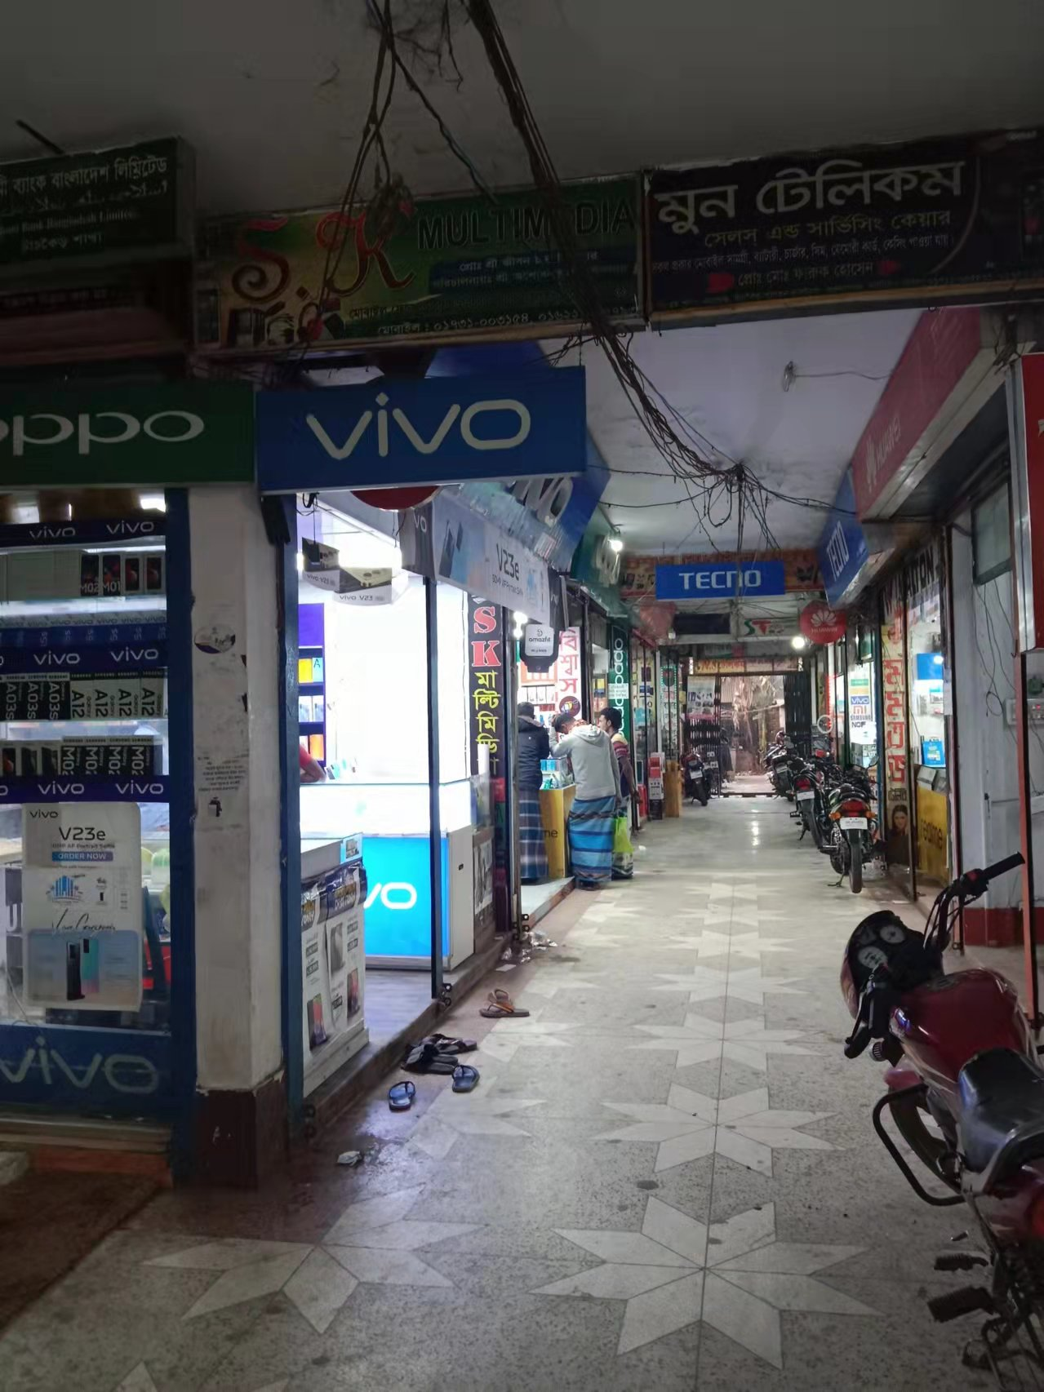
Natore Gurudaspur Thana Market (GRT)
Shop:
TTL 6 GRT Shop
TTL Sale: 335 Pcs
Average Sales : 56
Plan: Some Sticker Branding
Sales Universe: 56
R SO: 8
V SO: 7
O SO: 5
S SO: 6
X SO: 3
T SO: 3
I SO: 3
Others: 20

Slide 20
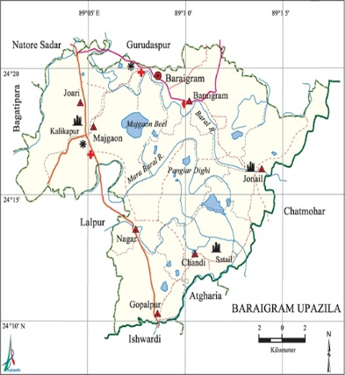
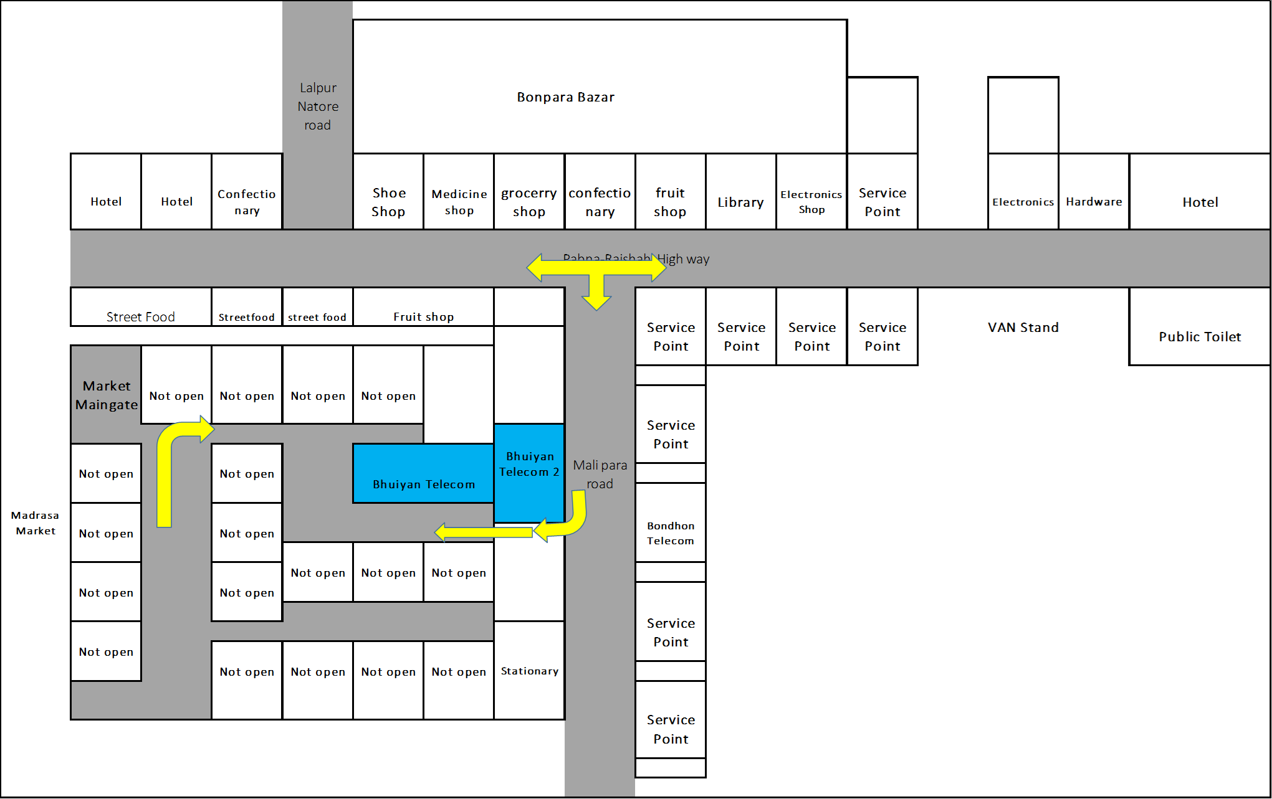
Natore Boraigram Thana Market:
A. Market Review
Sales Universe: 515
R SO: 64
R MKT Share: 12.42%
V SO:99
V MKT Share:19.28%
O SO:72
O MKT Share:13.98% X SO:36
X MKT Share:6.99%
S SO:59
S MKT Share:11.45%
T SO:34
T MKT Share:6.53%
I SO:31
I MKT Share:5.95%
Other:120
I MKT Share:23.30%
B. Retail Universe: 8
R WOD: 8
V WOD-6
O WOD: 8
X WOD: 5 S WOD:8
T WOD: 4
I WOD: 4
Others WOD: 8
C. BS Universe: 0
R BS: 0
R BS Share: 0
V BS: 0
V BS Share: 0
O BS: 0
O BS Share:0 X BS: 0
X BS Share:0
S BS: 0
S BS Share:0
T BS:0
I BS: 0
Other: 0
D. CS Universe: 0
R CS: 0
R CS Share:0
V CS:0
V CS Share:
O CS:0
O CS Share:0 X CS: 0
X CS Share: 0
S CS: 0
S CS Share: 0
T CS: 0
T CS Share: 0
I CS: 0
I CS Share: 0
Other: 0
Others CS Share:0
E. Universe: 8
R : 8(64pcs)
R Share: 100%
V : (99pcs)
V Share: 750%
O :8(72pcs)
O Share: 100% X : 5(36 pcs)
X Share: 62.5%
S : 8(59 pcs)
S Share: 100%
T : 4 (34pcs)
T Share: 50%
I : 4(31pcs)
I Share: 50%
Other: 8 (120pcs)
Others Share:100%
F. realme Dealer: 1
TTL Investment: 90Lac
Inventory: 9.5 Lac
TTL Market due: 7Lac
Lalpur Market Due: .75 lac
G. realme RSM: 1
realme ASM: 1
TSM: 1
Main market – Natore Distance
Market Map –BoraigramThana

Slide 21
Natore Boraigram Thana Market (BS)
No Brand shop

Slide 22
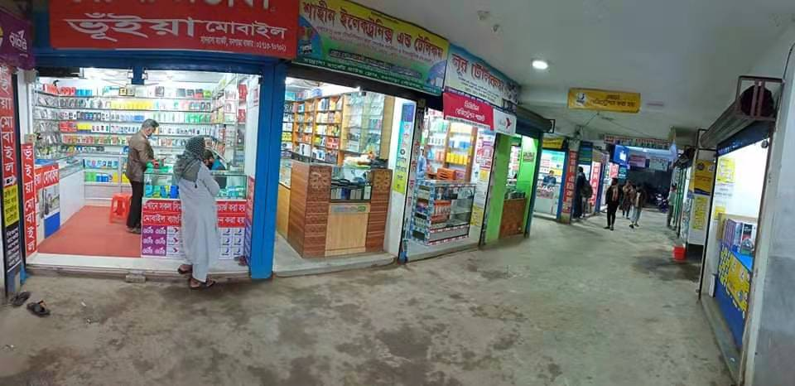
Natore Boraigram Thana Market (GRT)
Shop:
TTL 8 realme GRT Shop
TTL Sale: 515 Pcs
Average Sale: 64
E. GRT Universe: 8
R : 8pcs
V : 12pcs
O :9pcs X : 5 pcs
S : 7 pcs
T : 4pcs
I : 4pcs
Other: 15pcs
Plan: Some Sticker Branding , Signboard

Slide 23
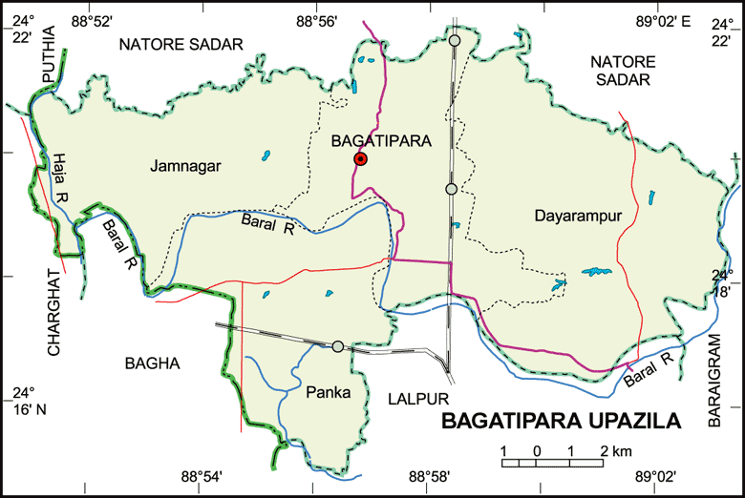
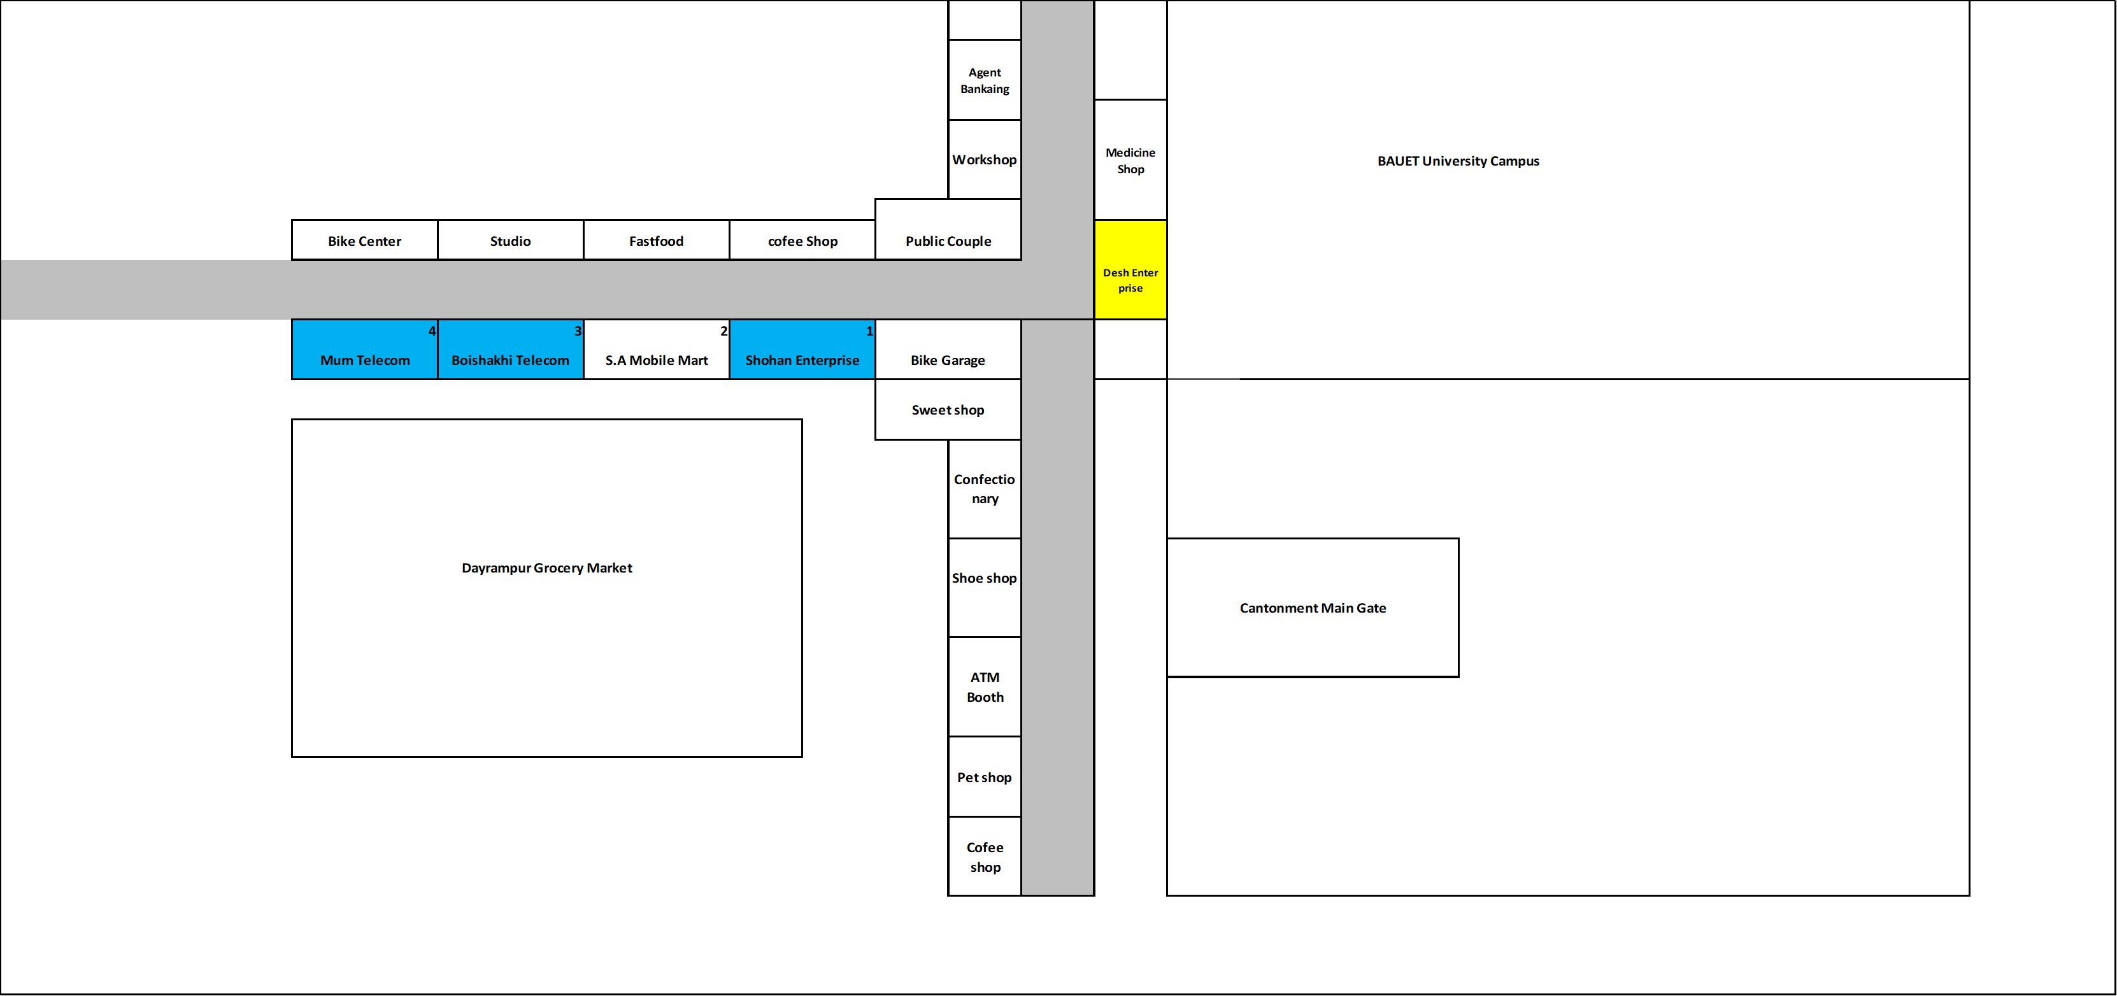
Natore Bagatipara Thana Market:
A. Market Review
Sales Universe: 308
R SO: 41
R MKT Share: 13.31%
V SO:73
V MKT Share:23.59%
O SO:40
O MKT Share:12.88% X SO:17
X MKT Share:5.62%
S SO:34
S MKT Share:11.14%
T SO:14
T MKT Share:4.65%
I SO:11
I MKT Share:3.46%
Other:78
I MKT Share:25.32%
B. Retail Universe: 6
R WOD: 6
V WOD-4
O WOD: 6
X WOD: 4 S WOD:6
T WOD: 4
I WOD: 3
Others WOD: 6
C. BS Universe: 0
R BS: 0
R BS Share: 0
V BS: 0
V BS Share: 0
O BS: 0
O BS Share:0 X BS: 0
X BS Share:0
S BS: 0
S BS Share:0
T BS:0
I BS: 0
Other: 0
D. CS Universe: 0
R CS: 0
R CS Share:0
V CS:0
V CS Share:
O CS:0
O CS Share:0 X CS: 0
X CS Share: 0
S CS: 0
S CS Share: 0
T CS: 0
T CS Share: 0
I CS: 0
I CS Share: 0
Other: 0
Others CS Share:0
E. Universe: 6
R : 6(41pcs)
R Share: 100%
V : 4(73pcs)
V Share: 80%
O :6(40pcs)
O Share: 100% X : 4(17 pcs)
X Share: 80%
S : 6(34 pcs)
S Share: 100%
T : 4 (14pcs)
T Share: 80%
I : 3(11pcs)
I Share: 50%
Other: 6 (78pcs)
Others Share:100%
F. realme Dealer: 1
TTL Investment: 90Lac
Inventory: 6 Lac
TTL Market due: 7Lac
Lalpur Market Due: .25 lac
G. realme RSM: 1
realme ASM: 1
TSM: 1
Main market – Natore Distance
Market Map – Bagatipara Thana

Slide 24
Natore Bagatipara Thana Market (BS)
No Brand shop

Slide 25
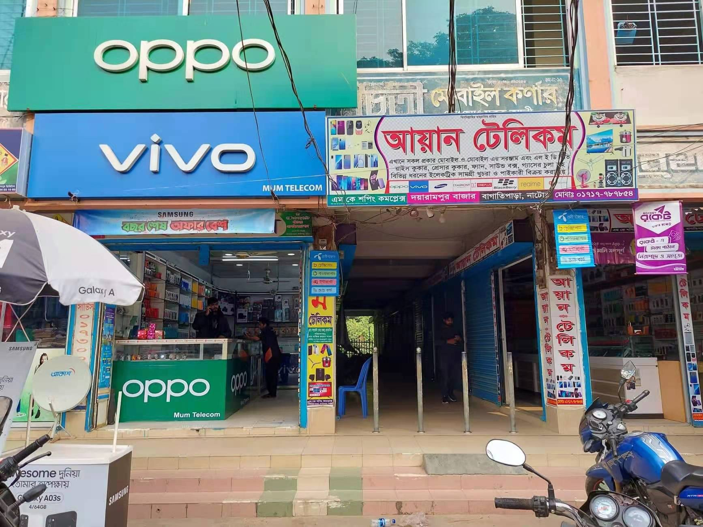
Natore Bagatipara Thana Market (GRT)
Shop:
TTL 6 GRT Shop
TTL Sale: 308 Pcs
Average Sale: 52pcs
E. Universe: 6
R : 7pcs
V : 12pcs
O :7pcs X : 3 pcs
S : 6 pcs
T : 2pcs
I : 2pcs
Other:13pcs
Plan: Some Sticker Branding , Signboard

Slide 26
Thanks

